Slide 1

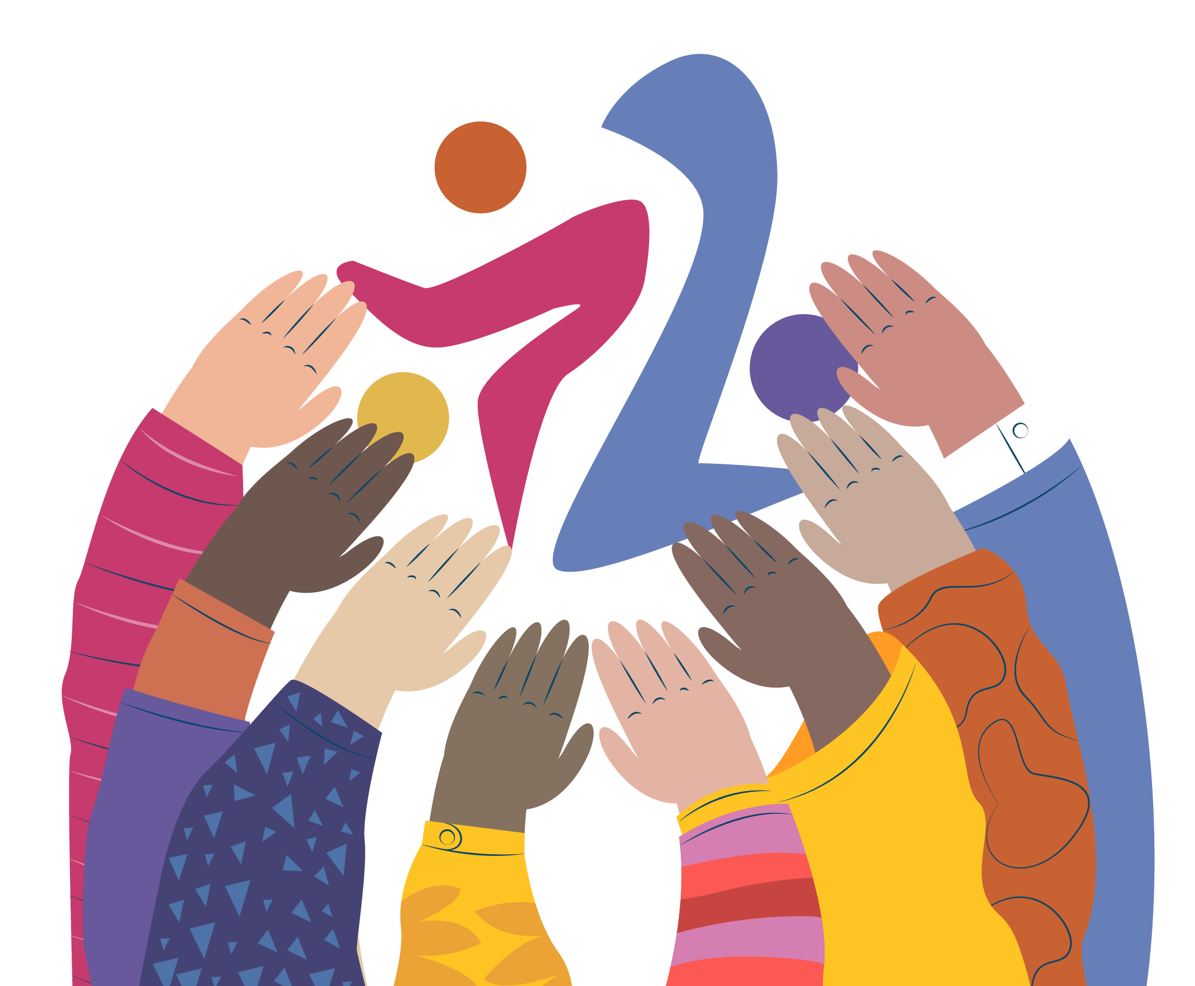
Future Worker… But also Citizen!
Vocational Education and Training (VET) must prepare students for more than just employment – it should empower them as informed, active members of society
Education for Work and Life – VET shouldn't just train hands: it should also shape minds. Life skills, critical thinking, and civic responsibility are just as essential as job-specific skills.
Your Voice Matters – Join our Student Union! Being part of your student union means having a say in how your education works for you. Engage in decisions, shape your learning environment, and stand up for your rights as a learner and citizen.
Don’t settle for a system that only sees you as labour. Get involved. Be heard. Be more than a worker—be a citizen.

Slide 3
Future Worker… But also Citizen!
Vocational Education and Training (VET) must prepare students for more than just employment – it should empower them as informed, active members of society.
Education for Work and Life – VET shouldn't just train hands: it should also shape minds. Life skills, critical thinking, and civic responsibility are just as essential as job-specific skills.
Your Voice Matters – Join our Student Union! Being part of your student union means having a say in how your education works for you. Engage in decisions, shape your learning environment, and stand up for your rights as a learner and citizen.
Citizenship is a Competence Too – Informed citizens build stronger communities and democracies. VET should include space for exploring ethics, social justice, and civic engagement.
The Right to Holistic Development – Students deserve an education that sees them as whole people, not just future employees. Emotional intelligence, self-expression, and social participation should be central to learning.
Don’t settle for a system that only sees you as labour. Get involved. Be heard. Be more than a worker—be a citizen.

Slide 5

Future Worker… But also Citizen!
Vocational Education and Training (VET) must prepare students for more than just employment – it should empower them as informed, active members of society.
Education for Work and Life – VET shouldn't just train hands: it should also shape minds. Life skills, critical thinking, and civic responsibility are just as essential as job-specific skills.
Your Voice Matters – Join our Student Union! Being part of your student union means having a say in how your education works for you. Engage in decisions, shape your learning environment, and stand up for your rights as a learner and citizen.
Citizenship is a Competence Too – Informed citizens build stronger communities and democracies. VET should include space for exploring ethics, social justice, and civic engagement.
The Right to Holistic Development – Students deserve an education that sees them as whole people, not just future employees. Emotional intelligence, self-expression, and social participation should be central to learning.
Don’t settle for a system that only sees you as labour. Get involved. Be heard. Be more than a worker—be a citizen.

